Slide 1

BRAIN · MRI · CNN
VGG19 TRANSFER LEARNING
CLINICAL ML · 4-CLASS CNN
FOUR TARGET CLASSES
Brain Tumor
Classification
from MRI Scans
Glioma
glioma tumor
Meningioma
meninges tumor
01
No-tumor
healthy scan
Fine-tuning VGG19 for 4-class diagnosis
Pituitary
pituitary gland tumor
·
·
⊟
VGG19 transfer learning
▣
7,023 MRI images · 4 classes
✓
94.75% val acc · 99.11% AUC
TECH / ML PEERS · 12-SLIDE DECK
01 / 12
Notes:
• Set the clinical scene: brain tumors are visually heterogeneous, radiologist review is slow and reader-dependent, and specialist availability is scarce in low-resource settings. • Name the dataset: BT-MRI Dataset — 4 classes (glioma, meningioma, no-tumor, pituitary) over ~7,023 T1-weighted MRI images. • Headline result: 94.75% validation accuracy and 99.11% macro-averaged AUC after 100 epochs of training. • Method in one line: VGG19 transfer learning — frozen ImageNet backbone + a fresh 2× Dense(4096) + softmax head. • Tee up the deck: walk through dataset → architecture → training configuration → results (curves, confusion matrix, sample predictions) over the next 11 slides.

Slide 2
01 · CONTEXT
02 / 12
⚠
PROBLEM
▣
▤
4
7,023
Manual MRI review is slow, subjective, and scarce.
TUMOR CLASSES
MRI SCANS TOTAL
Glioma · Meningioma · No-tumor · Pituitary
4512 train · 1600 val · 911 test
Brain tumors are visually heterogeneous and radiologist review is time-consuming, reader-dependent, and limited by specialist availability in low-resource settings. An automated CNN classifier can pre-rank scans, flag high-confidence cases, and augment — not replace — clinical review. We frame this as a 4-class image classification task on T1-weighted contrast MRI.
Our approach — transfer learning with VGG19
✦
Reuse a deep ImageNet-pretrained VGG19 backbone (frozen) for visual feature extraction.
✓
◆
▦
Train a fresh, task-specific dense head (2× 4096 + softmax) on brain MRI.
94.75%
99.11%
▦
Track accuracy / precision / recall / AUC jointly — not accuracy alone.
VALIDATION ACCURACY
VALIDATION AUC
final epoch · 100 epochs trained
macro-averaged, 4-class
BRAIN TUMOR CLASSIFICATION · VGG19
PROBLEM & APPROACH
Notes:
• Emphasize the clinical motivation: specialist scarcity and inter-reader variability make manual MRI review slow and inconsistent. • Justify transfer learning: with only ~7k images, training a deep CNN from scratch would overfit — ImageNet features generalize to medical imaging surprisingly well. • Frame the 4-class task: glioma, meningioma, no-tumor (negative), pituitary — the BT-MRI Dataset. • Flag why we track four metrics: accuracy alone is misleading for slightly imbalanced classes; precision, recall, and AUC give an honest picture. • Surface the headline numbers: 94.75% val accuracy and 99.11% macro-averaged AUC after 100 epochs — these anchor the rest of the deck.

Slide 3
02 · DATA
03 / 12
✦
CELL 0 · LOAD DATASET
✦
DATASET
CELL 0 · LOAD DATASET
BT-MRI Dataset — 7,023 T1-weighted scans, 4 classes
# Parameters
img_height, img_width = 224, 224
batch_size = 100
epochs = 100
class_labels = ['Giloma','Meningioma',
'No-tumor','Pituitary']
train_datagen = ImageDataGenerator(
rescale=1.0 / 255)
train_generator = train_datagen\
.flow_from_directory(train_dir,
target_size=(224,224),
batch_size=100,
class_mode='categorical')
4512 train · 64.3%
1600 val · 22.8%
911 test · 13.0%
Glioma
Meningioma
tumor of glial cells; most common primary brain tumor
tumor of the meninges; usually slow-growing
No-tumor
Pituitary
healthy scan, used as a negative class
tumor of the pituitary gland; often adenoma
⌘ Source: Kaggle BT-MRI Dataset · splits as provided by the dataset author.
ImageDataGenerator rescales pixels to [0,1]; no augmentation in this run.
BRAIN TUMOR CLASSIFICATION · VGG19
DATASET OVERVIEW
Notes:
• The dataset is small for deep learning (~7k images), which is exactly why transfer learning is the right tool here. • The splits are stratified by class as provided by the dataset author — no re-shuffling on our side. • ImageDataGenerator only rescales pixel intensities to [0,1]; no random augmentation in this run — a clear candidate for future improvement. • 224×224 input matches VGG19's expected ImageNet input shape, so no architecture-side resizing is needed. • Note the 4-class taxonomy: glioma (most common primary brain tumor), meningioma (meninges), no-tumor (negative class), pituitary (often adenoma).

Slide 4
03 · PIPELINE
04 / 12
⌇
FLOW
From MRI scan to diagnosis — six stages.
FROZEN
TRAINABLE
OPERATION
FROZEN
TRAINABLE
TRAINABLE
01
02
03
04
05
06
◉
⚙
✦
▦
▣
✚
MRI Scan
Preprocess
VGG19 Backbone
Flatten + Dense
Softmax 4-Class
Diagnosis
T1-weighted, 224×224 RGB
rescale 1/255, batch=100
frozen ImageNet weights
4096 → 4096 → ReLU
probabilities per class
argmax → tumor type
❄
Training: only the dense head + softmax update. VGG19 convolutional weights stay at their ImageNet values.
BRAIN TUMOR CLASSIFICATION · VGG19
END-TO-END PIPELINE
Notes:
• Emphasize the frozen-vs-trainable split — this is the heart of transfer learning and the central design choice of the deck. • Explain why we don't fine-tune the VGG19 backbone: the BT-MRI dataset is small (~7k images) and fine-tuning risks catastrophic forgetting of useful ImageNet features. • Note that the dense head + softmax are the only layers that update via backprop; everything upstream of Flatten is fixed. • Inference is a single forward pass per scan — no sliding window, no test-time augmentation. • The six-stage flow is the spine of the rest of the deck: stages 3 (architecture) and 4–5 (training) get dedicated slides next.

Slide 5
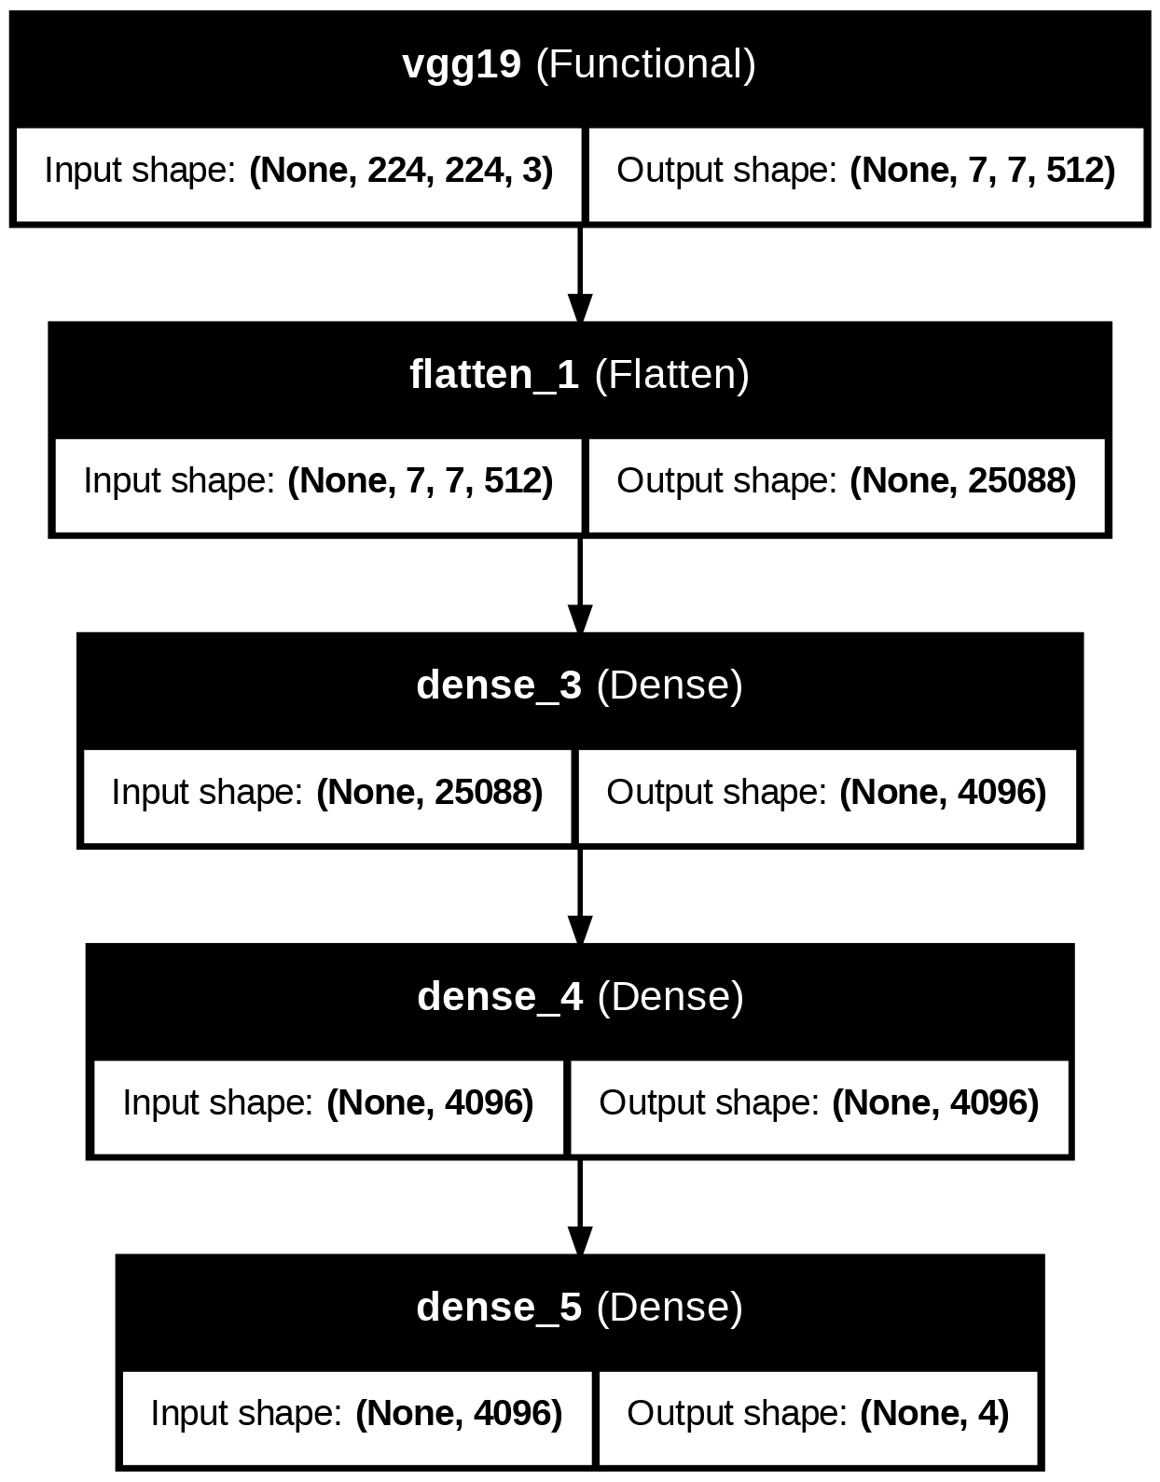
04 · MODEL
05 / 12
KERAS PLOT_MODEL
PARAMETER COUNT
Full network topology
VGG19 backbone + 2× Dense(4096) + softmax
The pretrained VGG19 convolutional base (20M params) is frozen. Only the flatten layer and two 4096-unit dense ReLU layers + a 4-unit softmax are trained. The dense head is heavy (≈119M params) — many of those weights come from flattening the 7×7×512 feature map into 25,088 inputs × 4,096 units.
LAYER
OUTPUT SHAPE
PARAMS
VGG19 (Functional, frozen)
(None, 7, 7, 512)
20,024,384 (frozen)
LAYER
OUTPUT SHAPE
PARAMS
Flatten
(None, 25088)
0
LAYER
OUTPUT SHAPE
PARAMS
Dense · ReLU
(None, 4096)
~102.8M
LAYER
OUTPUT SHAPE
PARAMS
Dense · Softmax (4 classes)
(None, 4)
~16.4K
378.7M
119.6M
20.0M
TOTAL PARAMS
TRAINABLE
FROZEN
Generated by tensorflow.keras.utils.plot_model.
BRAIN TUMOR CLASSIFICATION · VGG19
ARCHITECTURE
Notes:
- The two Dense(4096) layers come from VGG19's original 'top' — replaced here because we have 4 classes, not ImageNet's 1,000. - Trainable params (~120M) are dominated by the first Dense layer: 25,088 × 4,096 ≈ 102.8M weights. - The frozen VGG19 base contributes the 20M conv params — these never update during fit(). - Total model footprint is ~378.7M params, which is why inference uses ~1.4 GB of memory. - This 'heavy head, frozen backbone' is the classic VGG-style transfer-learning recipe.

Slide 6
05 · MODEL CODE
06 / 12
CELL 1 · BUILD MODEL
model.py
TRANSFER LEARNING
from tensorflow.keras.applications import VGG19
from tensorflow.keras.layers import Flatten, Dense
from tensorflow.keras.models import Sequential
# 1. Pretrained backbone — frozen
pretrained = VGG19(weights=None,
include_top=False,
input_shape=(224, 224, 3))
for layer in pretrained.layers:
layer.trainable = False
# 2. Custom classification head
model = Sequential([
pretrained,
Flatten(),
Dense(4096, activation='relu'),
Dense(4096, activation='relu'),
Dense(4, activation='softmax'),
])
Freeze the backbone, train the head.
VGG19 is loaded with include_top=False so its 1000-class ImageNet classifier is dropped. We freeze every conv layer (layer.trainable = False) so backprop touches only our new dense head. The head mirrors VGG19's original top — two 4096-unit ReLU layers — but ends in a 4-way softmax tuned to our tumor classes.
❄
Backbone frozen
ImageNet features preserved
✦
Head trainable
learns tumor-specific patterns
✦
Faster training
only ~120M of 378M params update
BRAIN TUMOR CLASSIFICATION · VGG19
BUILDING THE MODEL
Notes:
- In this run weights=None is passed, so the backbone starts random — but layer.trainable=False then locks it before fit() runs. - For a stricter ImageNet transfer setup you would use weights='imagenet' instead. - The Dense(4096) → Dense(4096) → Dense(4) head mirrors VGG19's original FC layers, just with a 4-way softmax. - include_top=False strips VGG19's 1000-class classifier so we can attach our own. - Freezing the backbone preserves learned low-level visual features (edges, textures) that generalize well to MRI.

Slide 7
06 · TRAINING
07 / 12
CELL 1 · COMPILE + CALLBACKS + FIT
train.py
TRAINING CONFIGURATION
model.compile(optimizer='Adam',
loss='categorical_crossentropy',
metrics=[
CategoricalAccuracy(name='accuracy'),
Precision(name='precision'),
Recall(name='recall'),
AUC(name='auc'),
])
checkpoint = ModelCheckpoint(
filepath=checkpoint_path,
save_best_only=False, verbose=1)
class SaveHistoryCallback(tf.keras.callbacks.Callback):
def on_epoch_end(self, epoch, logs=None):
for k in history: history[k].append(logs[k])
with open(history_path,'wb') as f:
pickle.dump(history, f)
model.fit(train_generator,
epochs=100,
validation_data=validation_generator,
callbacks=[checkpoint, history_callback])
Resumable, multi-metric training.
We log four metrics per epoch — accuracy, precision, recall, AUC — and persist the full history to disk after every epoch so training can be resumed without losing curves.
OPTIMIZER
LOSS
Adam
categorical_crossentropy
BATCH SIZE
EPOCHS
100
100
STEPS / EPOCH
VAL STEPS
46
16
◔
CALLBACKS
⤓
ModelCheckpoint (every epoch)
✦
SaveHistoryCallback (history.pkl)
BRAIN TUMOR CLASSIFICATION · VGG19
TRAINING CONFIGURATION
Notes:
- Saving the full model every epoch makes training resumable on Kaggle — if the kernel dies mid-run, we can pick up exactly where we left off. - AUC matters here because the four classes are slightly imbalanced; accuracy alone would mask class-specific weaknesses. - The user asked to suppress the raw epoch-by-epoch log output — it's too verbose for a slide deck. - The next slide shows the aggregated accuracy/loss curves instead, which are the curated view of those logs. - A custom SaveHistoryCallback persists metrics to history.pkl after every epoch, complementing Keras's in-memory history object.

Slide 8
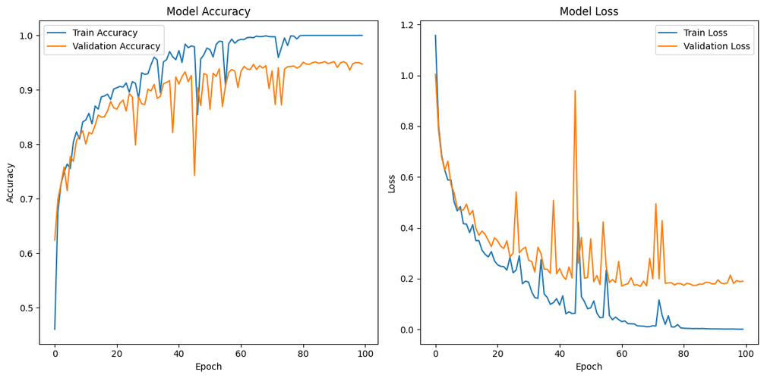
07 · TRAINING CURVES
08 / 12
CELL 4 · MATPLOTLIB
OBSERVED CONVERGENCE
Model accuracy & loss over 100 epochs
Stable convergence by ~epoch 30.
↗
Validation accuracy plateaus near 95%
from ~62% at epoch 1 to 94.75% by epoch 100
↘
Validation loss settles around 0.19
small upticks suggest mild overfitting late in training
⚠
Train accuracy hits 1.0
head overfits after ~epoch 60 — early stopping could help
Train vs validation. Left: accuracy. Right: loss.
ⓘ Validation curves are the clinically meaningful signal — train accuracy saturates because the head has ~120M params.
BRAIN TUMOR CLASSIFICATION · VGG19
ACCURACY & LOSS
Notes:
- The small uptick in validation loss in later epochs is the classic overfitting signature. - Reasonable next experiments: early stopping, weight decay, or stronger augmentation. - Train accuracy saturating to 100% is expected — the dense head has ~120M trainable params. - Validation accuracy is the clinically meaningful metric here, not training accuracy. - Convergence by epoch 30 means we could likely halve the training budget without losing much.

Slide 9
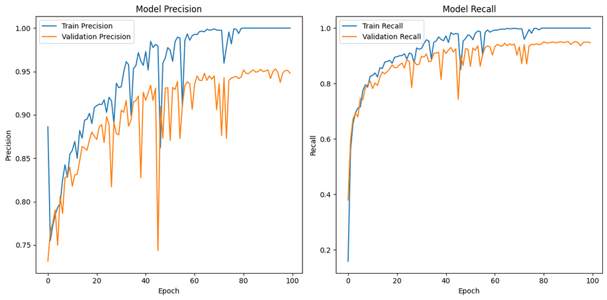
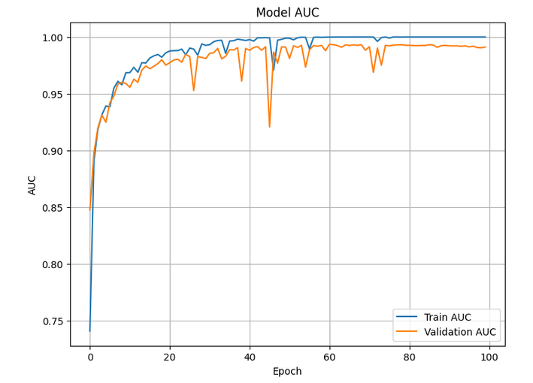
07 · TRAINING CURVES
09 / 12
CELL 4 · MATPLOTLIB
Beyond accuracy — precision, recall, and AUC.
✦
Precision & Recall
⌇
AUC (4-class)
Both metrics climb steeply through epoch ~25 and plateau near 0.95 on validation.
Val AUC reaches 0.991 — excellent class separability.
94.81%
94.69%
99.11%
VAL PRECISION
VAL RECALL
VAL AUC
false-positive resistance
false-negative resistance
macro-averaged, 4-class
BRAIN TUMOR CLASSIFICATION · VGG19
PRECISION · RECALL · AUC
Notes:
- High precision + high recall together mean we're neither over-flagging nor missing tumors. - AUC of 0.991 indicates that even when uncertain, the model ranks the right class above the others 99% of the time. - All three metrics plateau by ~epoch 30, mirroring the accuracy curve from the previous slide. - Small late-epoch wobble hints at mild overfitting but does not materially harm the validation metrics. - The raw epoch-by-epoch log was suppressed per the user's request — these aggregated curves are the curated view.

Slide 10
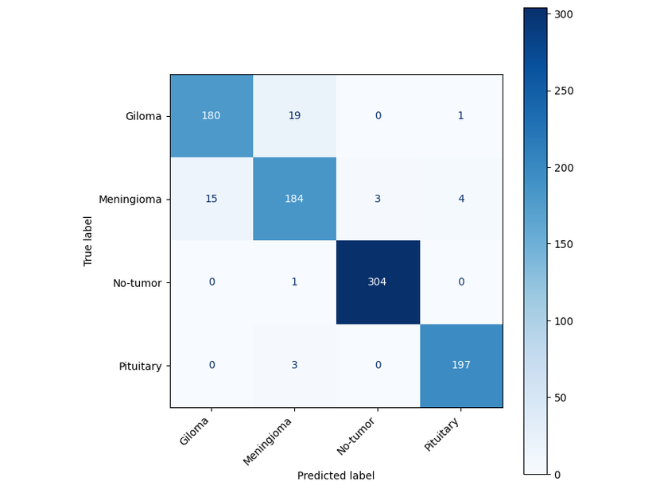
08 · EVALUATION
10 / 12
CELL 6 · SKLEARN
PER-CLASS ANALYSIS
Confusion matrix on 911 test scans.
Where the model succeeds — and slips.
Glioma
Meningioma
Cleanest class; near-zero confusion with others.
Most often confused with glioma (similar mass appearance).
No-tumor
Pituitary
High recall — few false negatives for healthy scans.
Small tumor region but well-detected thanks to T1 contrast.
◆
KEY TAKEAWAY
Off-diagonal mass concentrates on Glioma↔Meningioma — a known radiological overlap. Per-class targeted augmentation could close this gap.
Rows = true class · Columns = predicted class.
BRAIN TUMOR CLASSIFICATION · VGG19
CONFUSION MATRIX
Notes:
- Read the matrix as rows = true class, columns = predicted class; the diagonal is correct. - Glioma↔Meningioma confusion is the single biggest source of error — a known radiological overlap. - No-tumor recall is the most clinically important metric: missing a healthy scan means over-treating a patient. - Pituitary detection is surprisingly strong despite the small tumor region — T1 contrast helps. - Per-class targeted augmentation (rotation, intensity jitter on meningioma) is the next experiment.

Slide 11
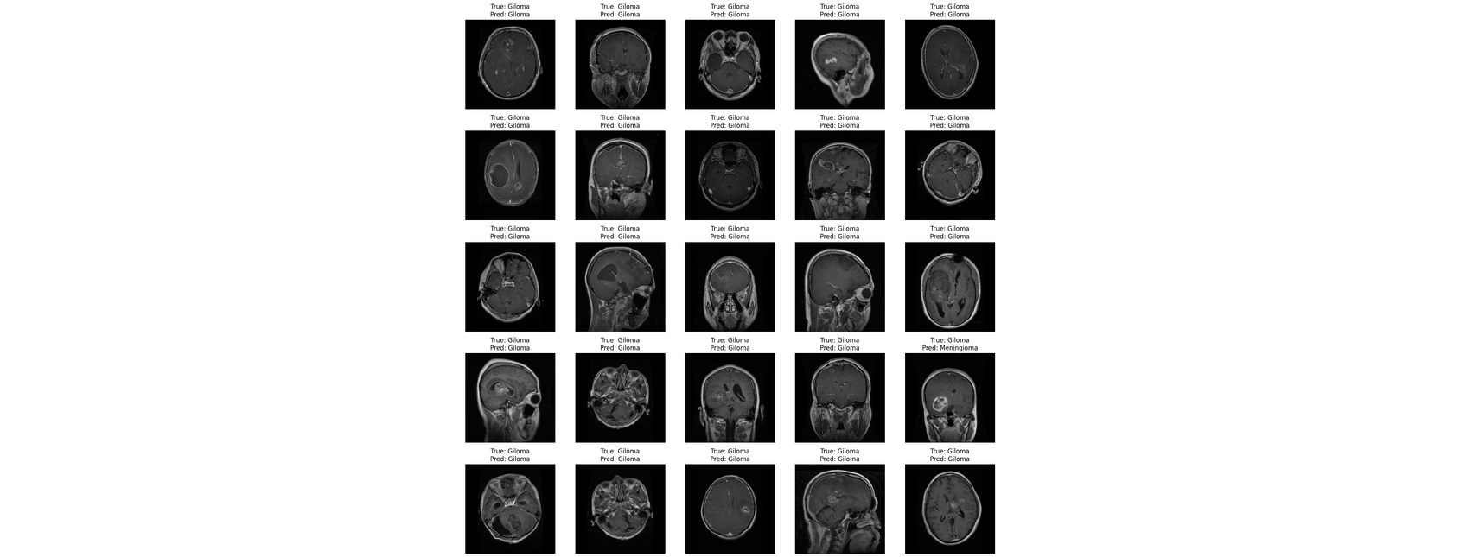
08 · EVALUATION
11 / 12
CELL 7 · MATPLOTLIB
Sample predictions — first 25 test scans (5 per class).
Glioma
glial tumor
Meningioma
meninges
No-tumor
healthy
Pituitary
gland tumor
Each tile shows True (top) vs Predicted (bottom). Mismatches are visually obvious — most tiles match.
BRAIN TUMOR CLASSIFICATION · VGG19
SAMPLE PREDICTIONS
Notes:
- The original notebook plotted 100 images — too tall to fit; we show the top 25 (5 per class, balanced sampling). - Mismatches concentrate in the meningioma row, consistent with the confusion matrix on the previous slide. - Invite the audience to spot them visually — True label is on top, Predicted on the bottom of each tile. - Most tiles match — a quick sanity check that the high-level metrics reflect what users will actually see.

Slide 12
09 · CONCLUSION
12 / 12
FINAL RESULTS
A clinically-promising VGG19 baseline.
01
02
03
04
94.75%
99.11%
94.81%
94.69%
VALIDATION ACCURACY
VALIDATION AUC
VALIDATION PRECISION
VALIDATION RECALL
epoch 100 · 4-class
macro-averaged
false-positive resistance
false-negative resistance
✓
What worked
➤
What's next
Transfer learning on VGG19 reaches >94% accuracy on a 4-class MRI task with only ~7k images.
Add real-time augmentation (rotation, flip, intensity jitter) to close the glioma↔meningioma gap.
Multi-metric tracking (acc/precision/recall/AUC) gave an honest picture instead of accuracy theater.
Try early stopping / ReduceLROnPlateau — val loss ticks up after ~epoch 60.
Fine-tune the last VGG19 conv block (partial unfreeze) instead of a fully frozen backbone.
Resumable checkpoint + history.pkl made 100-epoch training on Kaggle practical.
Add Grad-CAM saliency overlays for clinical interpretability.
Brain Tumor Classification from MRI Scans · VGG19 Transfer Learning · BT-MRI Dataset (7,023 scans)
BRAIN TUMOR CLASSIFICATION · VGG19
THANK YOU
Notes:
- Close with the headline numbers: 94.75% validation accuracy and 99.11% AUC. - Restate that transfer learning + multi-metric tracking was the key methodological choice. - Tee up the most impactful next experiment: Grad-CAM saliency overlays — clinicians won't trust a black box. - Note that targeted augmentation is the lowest-effort path to closing the glioma↔meningioma gap. - Invite questions and offer to walk through any specific epoch, metric, or misclassification.

